Slide 1
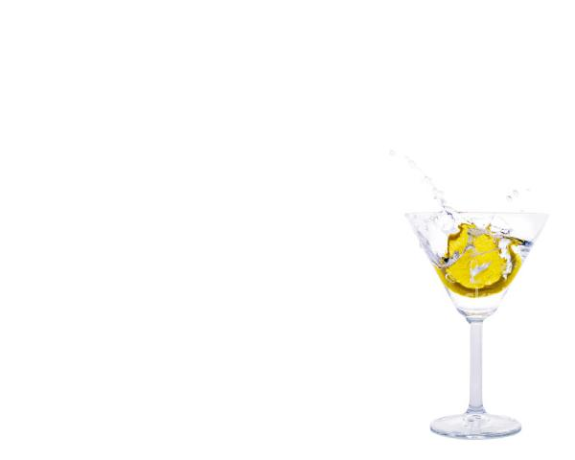
BP Bartender
A General Recommender System Using Backpropagation
Aaron Wolin
CS 152, Fall 2006

Slide 2
Project Goal
Create a general recommender system to rate cocktails
Train a backpropagation neural network to output quantitative ratings

Slide 3
Why General Model?
Can quickly determine an average rating for a drink without requiring user information
Avoids the user “ramp-up” problem

Slide 4
Data Collection
Input data as vectors of ingredients
Desired values obtained from www.webtender.com
Rating = 6.47
Vodka (oz) | Gin (oz) | Rum (oz) | Coke (oz) | Tonic (oz) | Mint | Lime
0.00 | 2.00 | 0.00 | 0.00 | 5.00 | 0 | 1

Slide 5
Ingredients
28 ingredients:
  Vodka, Rum, Gin, Whiskey, Tequila
  Sweet Vermouth, Dry Vermouth, Triple Sec, Crème De Minthe, Bailey's Irish Cream, Coffee Liqueur
  Coke, Club Soda, Tonic, Ginger Ale, Sour, Orange Juice, Pineapple Juice, Cranberry Juice, Grapefruit Juice, Grenadine, Cream
  Mint Leaves, Lime, Lemon, Cherry, Olive, Bitters

Slide 6
Features
6 features:
  Percent hard alcohol
  Percent alcoholic mixers
  Percent non-alcoholic mixers
  Number of alcoholic ingredients
  Number of non-alcoholic ingredients
  Total number of ingredients

Slide 7
Amusing Discoveries
Need to convert drinks to proportions
  Shot of vodka is good,
  Rating = 12.199
  2 Shots is even better
  Rating = 22.306

Slide 8
Preprocessing: Proportions
Convert all input vectors to deal with proportions
  1.50 oz Vodka, 2.50 oz Orange Juice
  0.25 Vodka, 0.75 Orange Juice

Slide 9
Network
34 x 68 x 24 x 1
(logsig x logsig x logsig x linear)
Learning rate = 0.01
MSE = 0.00001

Slide 10
Results
On a test set of 30 recipes:
  Mean MSE = 4.724518
  Median MSE = 2.200487
  Min = 0.00041 (6.12/6.13)
  Max = 20.391750 (3.88/8.40)

Slide 11
Demo and Questions

Slide 12
Future Work
More data
More training
More features
Hybrid system
  General model, but incorporate another layer for basic user preferences

